Slide 1
4
Telecommunications and Networking

Slide 2
What Is a Computer Network?
Network Fundamentals
The Internet and the World Wide Web
Network Applications

Slide 3
Compare and contrast the major types of networks.
Describe the wireline communications media and transmission technologies.
Describe the most common methods for accessing the Internet.
Explain the impact that networks have had on business and everyday life for each of the six major categories of network applications.

Slide 4

Get Rid of E-Mail? Seriously?
Is it feasible for your university to eliminate e-mail? Why or why not? Would you support such a policy at your school? Why or why not?
Describe the advantages and disadvantages of eliminating e-mail from an organization. Provide specific examples to support your answers.

Slide 5
4.1
What Is a Computer Network?
Computer Network
Bandwidth
Broadband
Local Area Networks
Wide Area Networks
Enterprise Networks
Notes:
Computer Network: a system that connects computers and other devices (e.g., printers) via communications media so that data and information can be transmitted among them.
Bandwidth: refers to the transmission capacity of a network; it is stated in bits per second.
Broadband: based on the Federal Communications Commission (FCC) 2010 definition, broadband is the transmission capacity of a communications medium (discussed late
Local Area Network (LAN): connects two or more devices in a limited geographical region, usually within the same building, so that every device on the network can communicate with every other device.
Wide Area Network (WAN): a network that covers a large geographical area. WANs typically connect multiple LANs. Th ey are generally provided by common carriers such as telephone companies and the international networks of global communications services providers. WANs have large capacity, and they typically combine multiple channels (e.g., fi ber-optic cables, microwave, and satellite). Th e Internet is an example of a WAN.
Enterprise Network: organizational interconnected networks consisting of multiple LANs and may also include multiple WAN's.r in this chapter) faster than 4 megabits per second (Mbps).

Slide 6
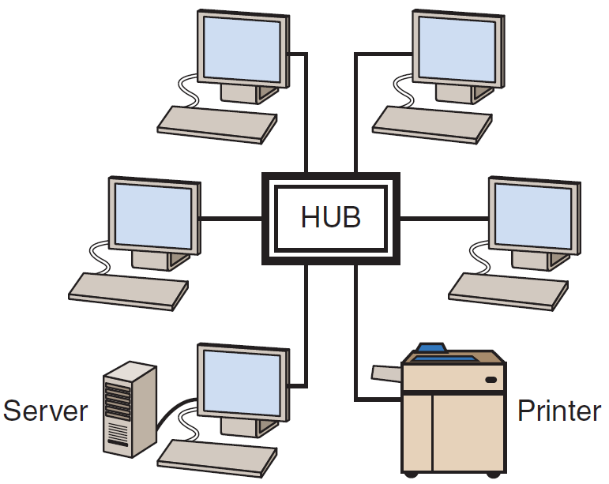
Figure 4.1: Ethernet Local Area Network (LAN)

Slide 7
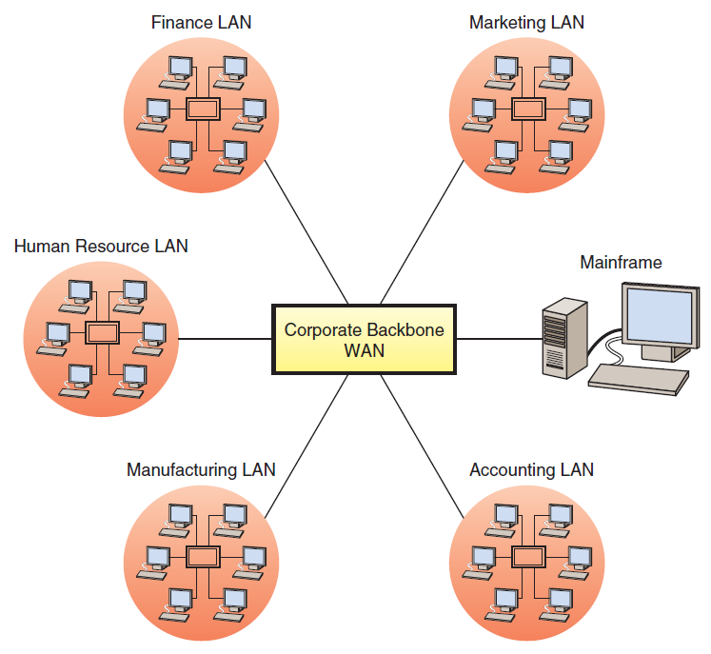
Figure 4.1: Ethernet Local Area Network (LAN)

Slide 8
4.2
Network Fundamentals
Analog and Digital Signals
Modem
Communications Media and Channels
Network Protocols
Types of Network Processing
Notes:
Analog Signals: continuous waves that transmit information by altering the characteristics of the waves. Analog signals have two parameters, amplitude and frequency.
Digital Signals: discrete pulses that are either on or off, representing a series of bits (0s and 1s). Th is quality allows digital signals to convey information in a binary form that can be interpreted by computers.
Modem (modulator-demodulator): converts digital signals to analog signals—a process called modulation—and analog signals to digital signals—a process called demodulation. (The name modem is a contraction of modulator–demodulator.)

Slide 9
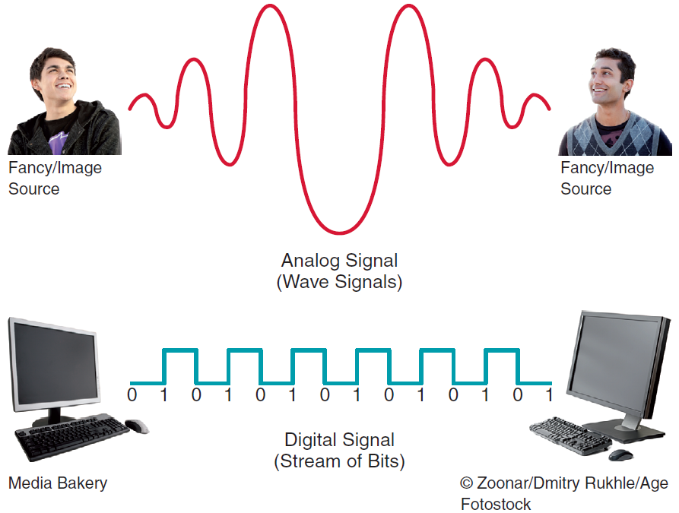
Figure 4.3: Analog and Digital Signals

Slide 10
Communications Media and Channels
Twisted-Pair Wire
Coaxial Cable
Fiber Optics
Notes:
Communications Channel: a pathway or medium communicating data from one location to another.
Communications Media: is the physical media used to send data (e.g., twisted-pair wire, coaxial cable, fiber optic cable, satellite, etc.).
Twisted-Pair Wire: the most prevalent form of communications wiring used for almost all business telephone wiring and As the name suggests, it consists of strands of copper wire twisted in pairs. It is relatively inexpensive to purchase, widely available, and easy to work with.
Coaxial Cable: a single strand of insulated copper wire. It is much less susceptible to electrical interference, and it can carry much more data than twisted-pair. It is commonly used to carry high-speed data traffic as well as television signals.
Fiber-Optic Cable: consists of thousands of very thin filaments of glass fibers that transmit information via light pulses generated by lasers. The fiber-optic cable is surrounded by cladding, a coating that prevents the light from leaking out of the fiber.

Slide 11
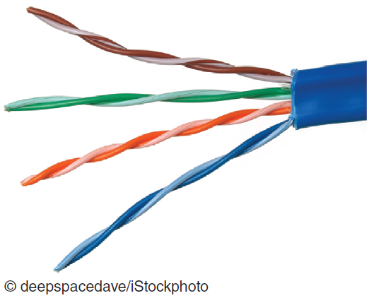
Communications Media: Twisted-Pair Wire
Notes:
Communications Channel: a pathway or medium communicating data from one location to another.
Communications Media: is the physical media used to send data (e.g., twisted-pair wire, coaxial cable, fiber optic cable, satellite, etc.).
Twisted-Pair Wire: the most prevalent form of communications wiring used for almost all business telephone wiring and As the name suggests, it consists of strands of copper wire twisted in pairs. It is relatively inexpensive to purchase, widely available, and easy to work with.
Coaxial Cable: a single strand of insulated copper wire. It is much less susceptible to electrical interference, and it can carry much more data than twisted-pair. It is commonly used to carry high-speed data traffic as well as television signals.
Fiber-Optic Cable: consists of thousands of very thin filaments of glass fibers that transmit information via light pulses generated by lasers. The fiber-optic cable is surrounded by cladding, a coating that prevents the light from leaking out of the fiber.

Slide 12
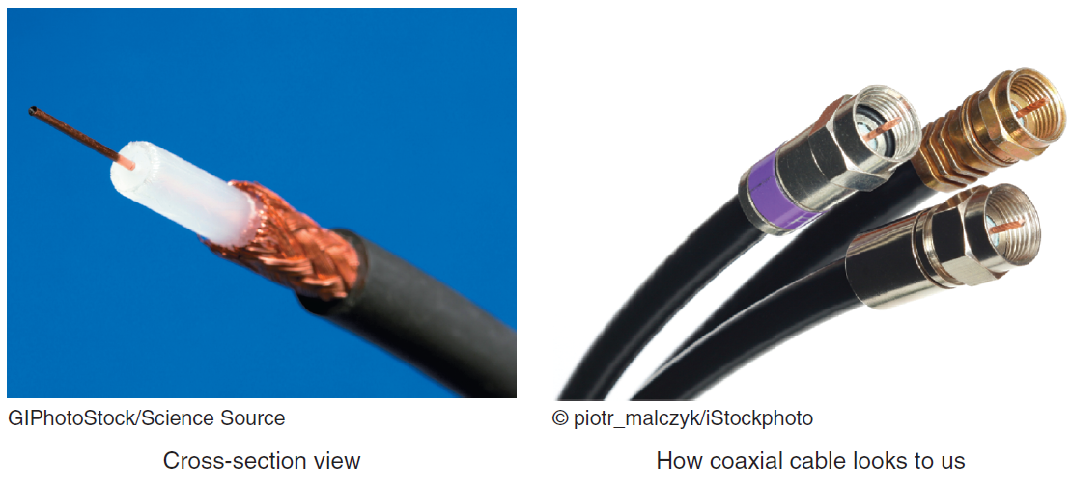
Communications Media: Coaxial Cable
Notes:
Communications Channel: a pathway or medium communicating data from one location to another.
Communications Media: is the physical media used to send data (e.g., twisted-pair wire, coaxial cable, fiber optic cable, satellite, etc.).
Twisted-Pair Wire: the most prevalent form of communications wiring used for almost all business telephone wiring and As the name suggests, it consists of strands of copper wire twisted in pairs. It is relatively inexpensive to purchase, widely available, and easy to work with.
Coaxial Cable: a single strand of insulated copper wire. It is much less susceptible to electrical interference, and it can carry much more data than twisted-pair. It is commonly used to carry high-speed data traffic as well as television signals.
Fiber-Optic Cable: consists of thousands of very thin filaments of glass fibers that transmit information via light pulses generated by lasers. The fiber-optic cable is surrounded by cladding, a coating that prevents the light from leaking out of the fiber.

Slide 13
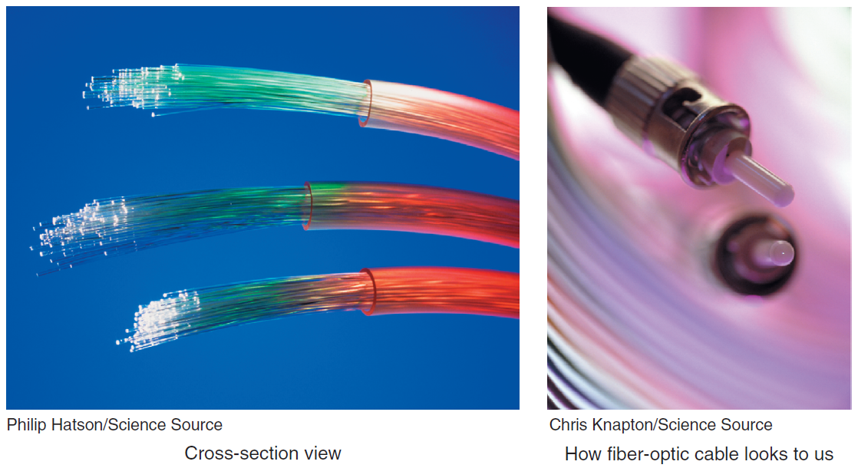
Communications Media: Fiber Optics
Notes:
Communications Channel: a pathway or medium communicating data from one location to another.
Communications Media: is the physical media used to send data (e.g., twisted-pair wire, coaxial cable, fiber optic cable, satellite, etc.).
Twisted-Pair Wire: the most prevalent form of communications wiring used for almost all business telephone wiring and As the name suggests, it consists of strands of copper wire twisted in pairs. It is relatively inexpensive to purchase, widely available, and easy to work with.
Coaxial Cable: a single strand of insulated copper wire. It is much less susceptible to electrical interference, and it can carry much more data than twisted-pair. It is commonly used to carry high-speed data traffic as well as television signals.
Fiber-Optic Cable: consists of thousands of very thin filaments of glass fibers that transmit information via light pulses generated by lasers. The fiber-optic cable is surrounded by cladding, a coating that prevents the light from leaking out of the fiber.

Slide 14
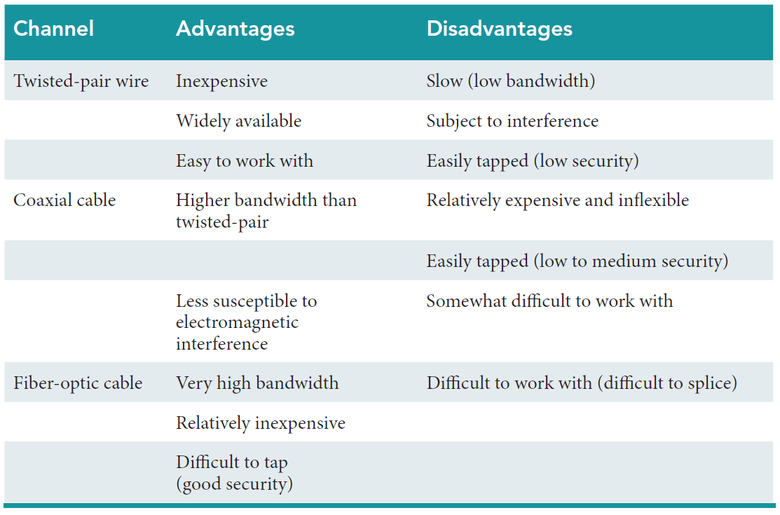
Table 4.1: Advantages and Disadvantages of Wireline Communications Channels

Slide 15
Network Protocols
Ethernet
Transmission Control Protocol / Internet Protocol (TCP/IP)
Notes:
Ethernet: A common LAN protocol. Many organizations use 100-gigabit Ethernet, where the network provides data transmission speeds of 100 gigabits (100 billion bits) per second.

Slide 16
Transmission Control Protocol / Internet Protocol
Three Basic Functions of TCP
Packets & Packet Switching
Four Layers of the TCP/IP Reference Model
Notes:
Transmission Control Protocol/Internet Protocol (TCP/IP): the protocol of the Internet. TCP/IP uses a suite of protocols, the main ones being the Transmission Control Protocol (TCP) and the Internet Protocol (IP).
--------------------
TCP performs three basic functions:
It manages the movement of data packets between computers by establishing a connection between the computers
it sequences the transfer of packets
it acknowledges the packets that have been transmitted
--------------------
Internet Protocol (IP): is responsible for disassembling, delivering, and reassembling the data during transmission.
Packets: Before data are transmitted over the Internet, they are divided into small, fixed bundles called packets.
Packet Switching: the transmission technology that breaks up blocks of data into packets is called packet switching. Each packet carries the information that will help it reach its destination—the sender’s IP address, the intended receiver’s IP address, the number of packets in the message, and the number of the particular packet within the message. Each packet travels independently across the network and can be routed through diff erent paths in the network. When the packets reach their destination, they are reassembled into the original message.

Slide 17
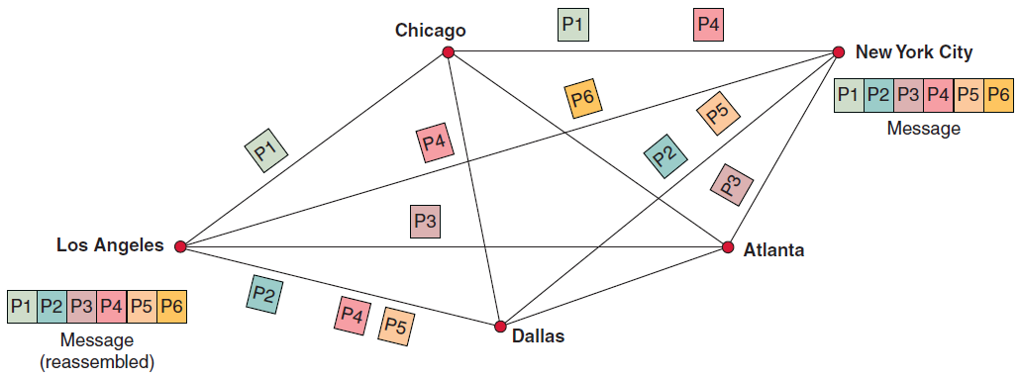
Figure 4.8: Packet Switching

Slide 18
Three Basic Functions of the TCP
Manages the movement of data packets between computers by establishing a connection between the computers
Sequences the transfer of packets
Acknowledges the packets that have been transmitted

Slide 19
Four Layers of the TCP/IP Reference Model
Application Layer
Transport Layer
Internet Layer
Network Interface Layer
Notes:
TCP/IP functions in four layers:
Application Layer: enables client application programs to access the other layers, and it defines the protocols that applications use to exchange data.
Transport Layer: provides the application layer with communication and packet services.
Internet Layer: responsible for addressing, routing, and packaging data packets.
Network Interface Layer: places packets on, and receives them from, the network medium, which can be any networking technology.

Slide 20
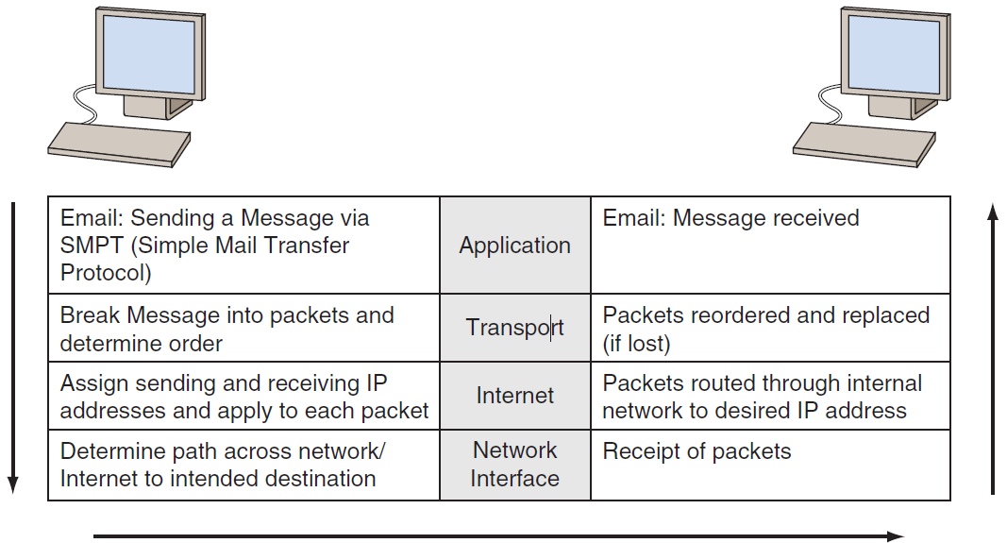
Figure 4.7: The Four Layers of TCP/IP Reference Model

Slide 21
Types of Network Processing
Distributed Processing
Client/Server Computing
Peer-to-Peer Processing
Notes:
Distributed Processing: divides processing work among two or more computers which enables computers in different locations to communicate with one another via telecommunications.
Client/Server Computing: Client/server computing links two or more computers in an arrangement in which some machines, called servers, provide computing services for user PCs, called clients.
Peer-to-Peer (P2P) Processing: a type of client/server distributed processing where each computer acts as both a client and a server. Each computer can access (as assigned for security or integrity purposes) all files on all other computers.

Slide 22
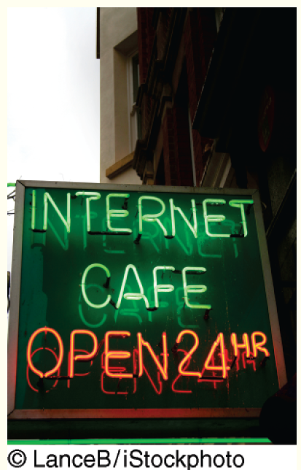
’S ABOUT BUSINESS 4.1
Internet Access in Cuba
Describe the advantages and disadvantages of the global Internet to Cuban citizens.
Describe the advantages and disadvantages of the global Internet to the Cuban government.

Slide 23
4.3
The Internet and the World Wide Web
Internet versus WWW
Accessing the Internet
The Future of the Internet
The World Wide Web
Notes:
-- The Internet and WWW are often used synonymously, but they are not the same thing.
World Wide Web: a system of universally accepted standards for storing, retrieving, formatting, and displaying information via a client/server architecture.
Internet: a network of networks… a global WAN that connects approximately 1 million organizational computer networks in more than 200 countries on all continents, including Antarctica. It has become so widespread that it features in the daily routine of nearly 2.5 billion people.
Intranet: a network that uses Internet protocols so that users can take advantage of familiar applications and work habits. Intranets support discovery (easy and inexpensive browsing and search), communication, and collaboration inside an organization.
Extranet: connects parts of the intranets of different organizations which enables business partners to communicate securely over the Internet using virtual private networks (VPNs)

Slide 24
Accessing the Internet
Connecting via an Online Service
Connecting via Other Means
Internet kiosks
Smart phones and iPads
Cybercafes
Addresses on the Internet

Slide 25
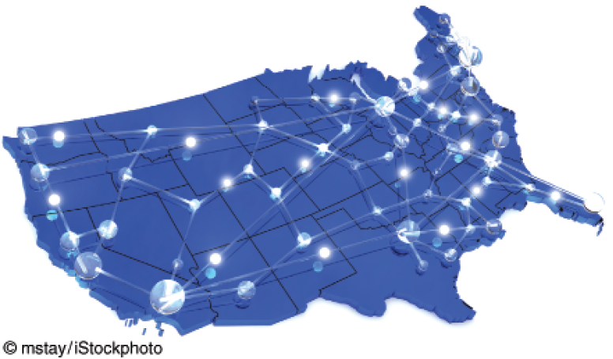
Figure 4.9: Internet (backbone in white)

Slide 26
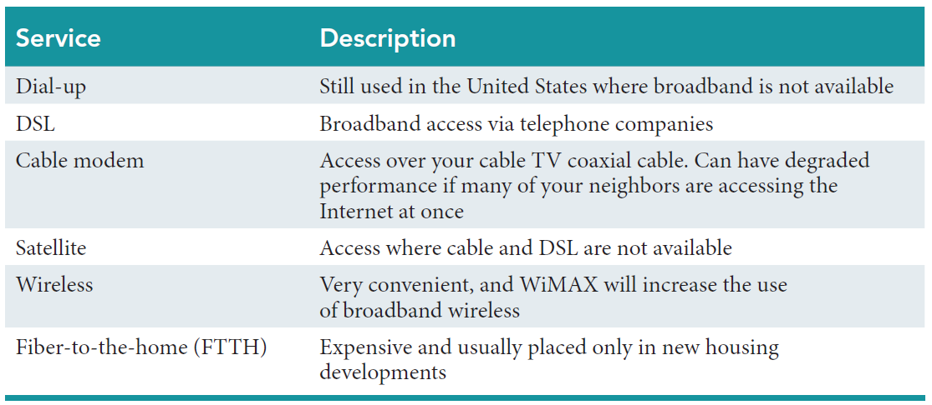
Table 4.2: Internet Connection Methods

Slide 27
Future of the Internet
Experts are concerned that Internet users will experience brownouts from 3 factors:
increasing number of people working online
Popularity of Web sites such as YouTube requiring large amounts of bandwidth
Demand for high-definition television delivered over the Internet
Notes:
The Future of the Internet: Consumer demand for content delivered over the Internet is increasing rapidly, and many experts are now concerned that
Internet users will experience brownouts from three factors:
the increasing number of people who work online
the soaring popularity of Web sites such as YouTube that require
large amounts of bandwidth
the tremendous demand for high-definition television delivered over the Internet.

Slide 28
The World Wide Web (WWW)
World Wide Web
Internet
Intranet
Extranet
Notes:
World Wide Web: a system of universally accepted standards for storing, retrieving, formatting, and displaying information via a client/server architecture.
Internet: a network of networks… a global WAN that connects approximately 1 million organizational computer networks in more than 200 countries on all continents, including Antarctica. It has become so widespread that it features in the daily routine of nearly 2.5 billion people.
Intranet: a network that uses Internet protocols so that users can take advantage of familiar applications and work habits. Intranets support discovery (easy and inexpensive browsing and search), communication, and collaboration inside an organization.
Extranet: connects parts of the intranets of different organizations which enables business partners to communicate securely over the Internet using virtual private networks (VPNs)

Slide 29
4.4
Network Applications
Discovery
Communication
E-learning and Distance Education
Virtual Universities
Telecommuniting
Notes:
Users can apply the Internet’s discovery capability to areas ranging from education to government services to entertainment to commerce.
Communication: a major category of network applications related to communication technologies delivered online (e.g., including e-mail, call centers,

Slide 30
Network Applications: Discovery
Search Engines and Metasearch Engines
Publication of Material in Foreign Languages
Portals
Notes:
Users can apply the Internet’s discovery capability to areas ranging from education to government services to entertainment to commerce.
Search Engine: a computer program that searches for specific information by keywords and then reports the results.
Metasearch Engines: search several engines at once and then integrate the findings to answer users’ queries.
Publication of Material in Foreign Languages: information on the Internet is written in many different languages, and automatic translation of Web pages is essential.
Portals: a Web-based, personalized gateway to information and knowledge that provides relevant information from different IT systems and the Internet using advanced search and indexing techniques.

Slide 31
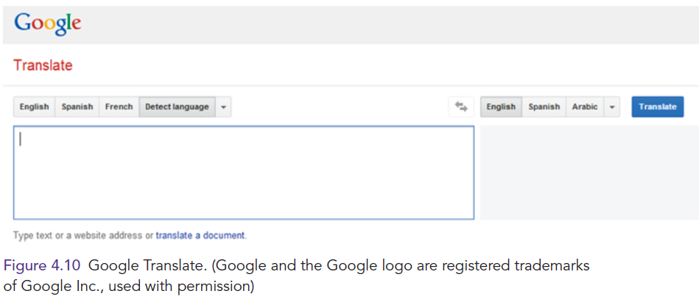
Publication of Materials in Foreign Languages

Slide 32
’S ABOUT BUSINESS 4.2
Just Exactly What Is Quara?
Is Quora a search engine, a knowledge-management system, or both? Provide specific examples to support your answer.
Is there an inherent problem with Quora itself selecting experts to whom the site sends questions? Support your answer.

Slide 33
Network Applications: Portals
Commercial portal
Affinity portal
Corporate portal
Industrywide portal
Notes:
Portals: a Web-based, personalized gateway to information and knowledge that provides relevant information from different IT systems and the Internet using advanced search and indexing techniques.
Commercial (public) Portal: the most popular type of portal on the Internet and is intended for broad and diverse audiences (e.g., a stock ticker).
Affinity Portal: offers a single point of entry to an entire community of affiliated interests, such as a hobby group or a political party.
Corporate Portal: offers a personalized, single point of access through a Web browser to critical business information located inside and outside an organization. These portals are also known as enterprise portals, information portals, and enterprise information portals.
Industrywide Portal: a portal that serves an entire industry (e.g., TruckNet <www.truck.net>).
Unified Communications: simplifies and integrates all forms of communications (voice, voice mail, fax, chat, e-mail, instant messaging, short message service, presence (location) services, and videoconferencing) on a common hardware and soft ware platform.

Slide 34
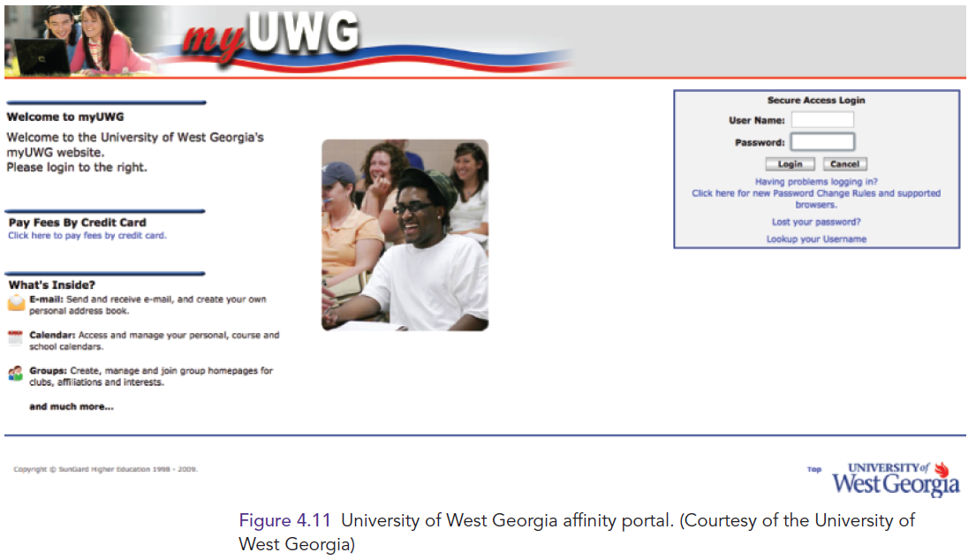
Affinity Portals

Slide 35
Network Applications: Communication
Electronic Mail
Web-Based Call Centers
Electronic Chat Rooms
Voice Communication
Voice Over Internet Protocol (VoIP)
Unified Communications
Collaboration
Electronic Teleconferencing
Notes:
Communication: a major category of network applications related to communication technologies delivered online (e.g., including e-mail, call centers, chat rooms, and voice).
Unified Communications: simplifies and integrates all forms of communications (voice, voice mail, fax, chat, e-mail, instant messaging, short message service, presence (location) services, and videoconferencing) on a common hardware and soft ware platform.
Electronic Teleconferencing: the use of electronic communication technology that enables two or more people at different locations to hold a conference.

Slide 36
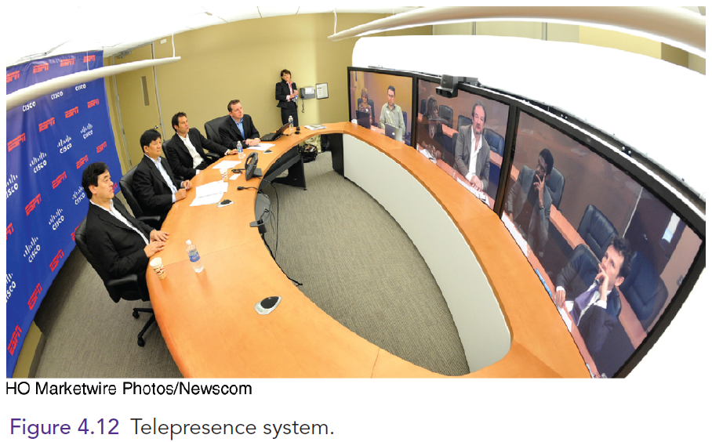
Telecommunication: Teleconferencing/Telepresence

Slide 37
Network Applications: Collaboration
Workgroup
Workflow
Virtual Team
Virtual Collaboration
Crowdsourcing
Synchronous versus Asynchronous
Collaboration Tools
Notes:
Workgroup: two or more individuals who act together to perform some task.
Workflow: the movement of information as it progresses through the sequence of steps that make up an organization’s work procedures. Workflow management makes it possible to pass documents, information, and tasks from one participant to another in a way that is governed by the organization’s rules or procedures.
Virtual Group (Team): Virtual groups conduct virtual meetings—that is, they “meet” electronically.
Virtual collaboration (or e-collaboration): the use of digital technologies that enable organizations or individuals who are geographically dispersed to collaboratively plan, design, develop, manage, and research products, services, and innovative applications.
Crowdsourcing: a process in which an organization outsources a task to an undefined, generally large group of people in the form of an open call.
Synchronous Collaboration: all team members meet at the same time.
Asynchronous Collaboration: occurs when team members cannot meet at the same time.

Slide 38
Collaboration Tools
Microsoft Sharepoint
Google Drive
IBM Lotus Quikr
Jive

Slide 39
Network Applications: E-Learning versus Distance Education
E-Learning
Distance Education
Notes:
E-learning: learning supported by the Web. It can take place inside classrooms as a support to conventional teaching, such as when students work on the Web during class. It also can take place in virtual classrooms, in which all coursework is completed.
Distance Learning (DL): refers to any learning situation in which teachers andstudents do not meet face-to-face.

Slide 40
Virtual Universities
University of Phoenix
California Virtual Campus
University of Maryland

Slide 41
Network Applications:
Telecommuting
Knowledge workers
Digital Nomads
Notes:
Telecommuting: the process in which highly prized “knowledge” workers are now able to work anywhere and anytime.
Knowledge workers are being called the distributed workforce, or “digital nomads.”

Slide 42

’S ABOUT BUSINESS 4.3
Yahoo! CEO Marissa Mayer Bans Telecommuting
Do you feel that Yahoo! is making the correct decision of banning telecommuting? a. Present the pro side of this issue (i.e., Mayer’s side). b. Present the con side of this issue.
This IT’s About Business was written in March 2014. Take a look at www.yahoo.com to see how the company is doing. Also, check on news articles about the ongoing fallout from Mayer’s decision.
Discuss Mayer’s internal memo quoted above. Do you agree or disagree with it? Support your answer.

